Slide 1

XYZ Superstore Time Series Model
By erik castro// flatiron school

Slide 2

Problem Statement
Improve workforce in the superstore
Make Data Driven Recommendations
Model to predict sales in Furniture and Office Supplies
Create a Time Series Model that can predict when sales will increase.

Slide 3
Busines Value
Understanding sales Seasonalities
Investigate if this data can be used to predict future sales numbers
Use predictions to make recommendations

Slide 4
Methodology
Frame the Problem
Collect Raw Data
Process the Data
Explore the Data/ Perform In-Depth Analysis
Train and Evaluate Models
Communicate results
Notes:
Frame the problem: Identify business priorities and make strategic decisions that will lead my work
Collect raw data: Extract data from the database provided.
Process the Data: Understand the data and proceed to clean it.
Explore the data: Split the data in different ways and use statistics to test and create visualizations to interpret data
Train and Evaluate Models: Create Time Series Models to predict future sales numbers.
Communicate Results

Slide 5
Collect Raw Data and Process the Data
There are +9,000 sales data entries
Originally there were 21 features. However, only Order Date and Sales columns were necessary
Clean data: Missing values, making Order Date index, Grouping sales by month.
Notes:
There are more than 9,000 sales data entries in this dataset. There were 21 features in this dataset, however for Time series analysis we only need two, in this case Order Date and Sales.
Cleaning the data was different in here. There is the obvious data cleaning procedure, such as missing values. We also had to change the index of the data to be Order Date.
And do Aggregation which is grouping sales by month.

Slide 6
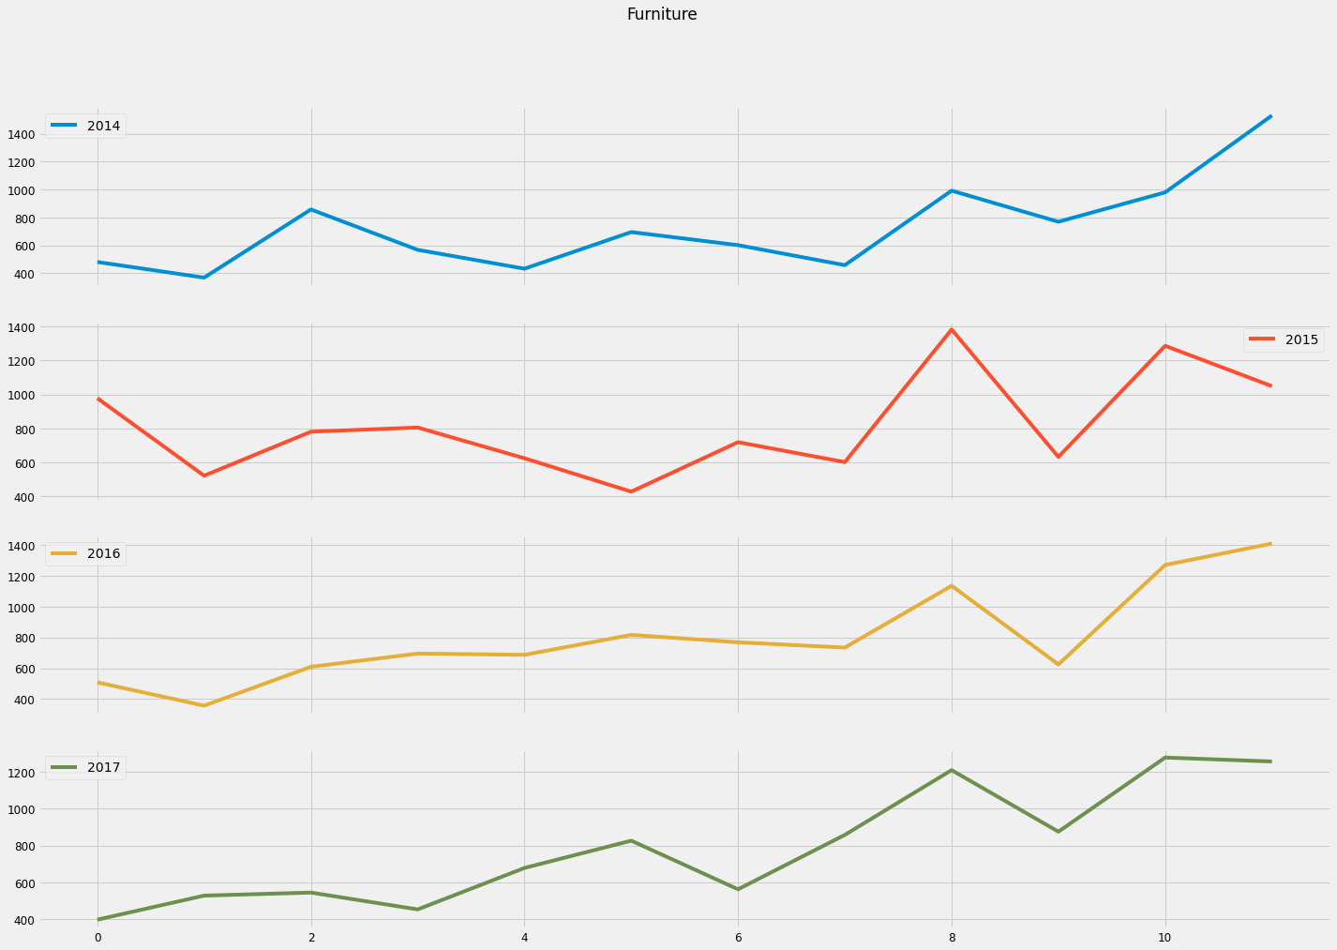
Explore Data/Perform In-depth Analysis Furniture
Notes:
Using the line graph throughout the years, we can appreciate that there is a year seasonality pattern. For furniture, during the months of September, November and December there is an increase of sales. There is a massive decrease of sales during October.

Slide 7
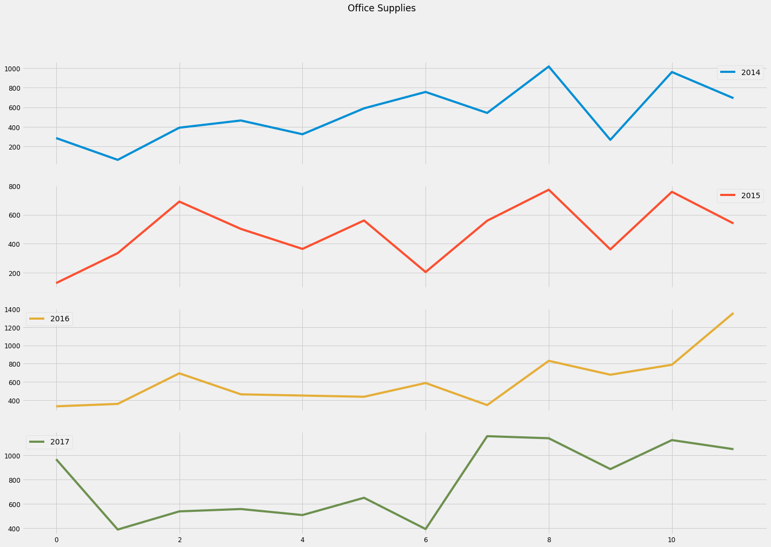
Explore Data/Perform In-depth Analysis Office Supplies
Notes:
For Office Supplies, sales are more constant, there are more sales overall throughout the year. However, months September, November and December are also notably higher.
There is also a decrease in October.

Slide 8
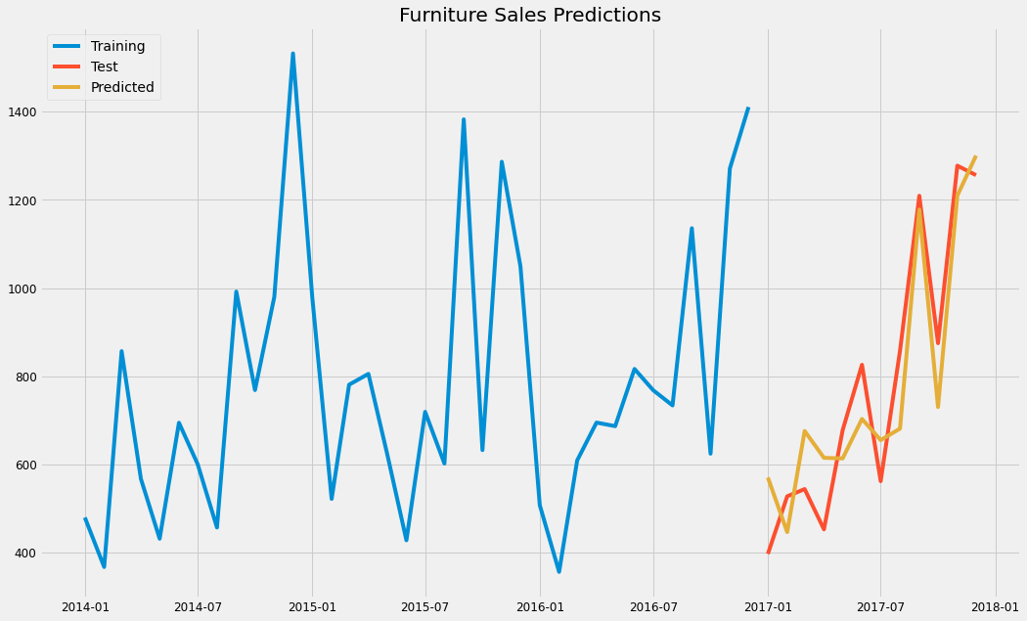
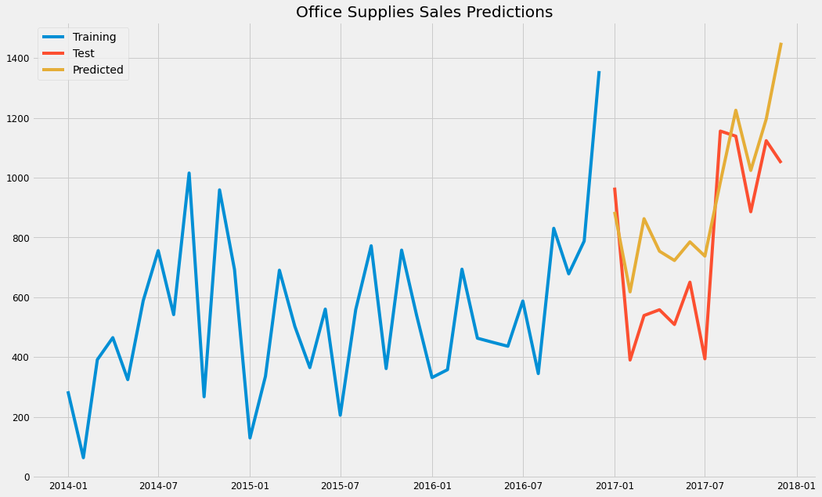
Train and Evaluate Models
Notes:
Predictions are quite close to the actual number. As with any time series model the prediction will not be 100% accurate. However, based on both graphs we can see that the predicted models do show the year seasonality.

Slide 9
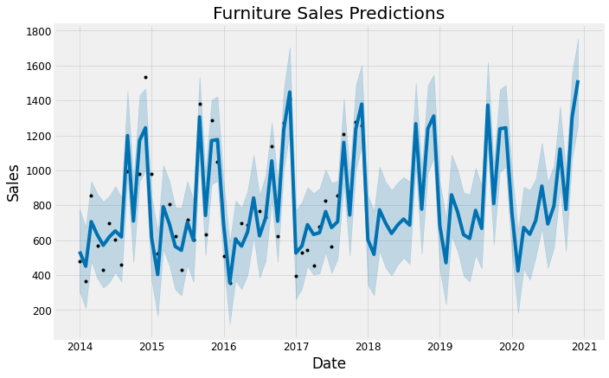
Recommendations - Furniture
Increase of workforce when sales are higher. September, October and December
Increase of stock before the high-sales months
Notes:
Recommendations for furniture, September, October and December are the months when sales spike up dramatically. This indicates that:
A minimum personnel is to be maintained throughout these months, perhaps even increasing workforce.
Increasing stock this month is also recommended as sales will increase .
January to May are quiet months therefore personnel can be redirected to different departments.

Slide 10
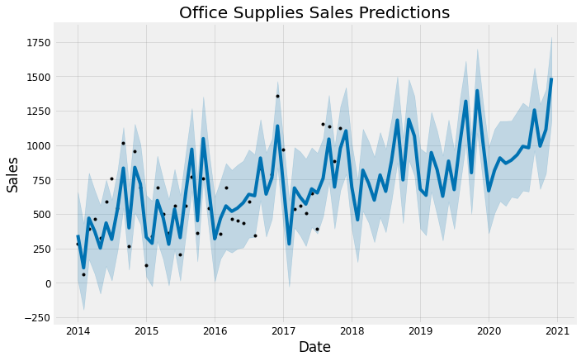
Recommendations – Office Supplies
Increase of workforce when sales are higher, September, October and December.
Increase of stock before the high-sales months
Maintain a minimum number of employees
Notes:
Recommendations for the office supplies department, during the months of September, October and December the sales increase dramatically. Therefore, it is recommended:
To hire more personnel as this will be needed.
It is also recommended to have enough stock to maintain a high quality service for every customer that desires to buy Office Supplies.
Sales in Office Supplies increase steadily throughout the years, therefore, maintaining a minmium number of employess in this section is recommended

Slide 11
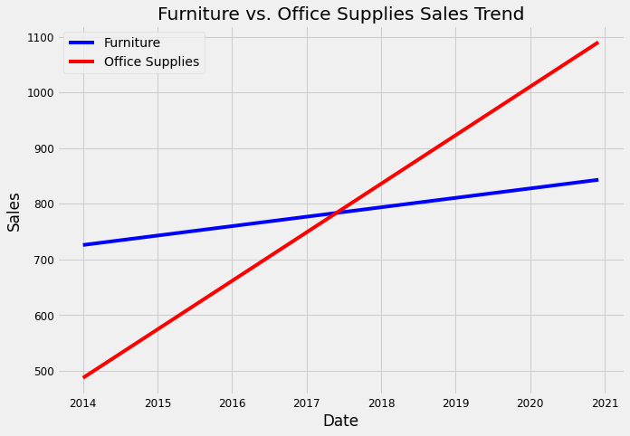
Recommendations- Trend
Volume sales per month increase exponentially
Increase of workforce in office supplies is recommended
Notes:
The volume of sales per month for both Office Supplies and Furniture, increase steadily over time. However, Office Supplies does trend higher than Furniture. It is recommended to spend more resources in Office Supplies department as it has a higher probability to be more profitable than furniture in the long run.

Slide 12
Future Work
Extra column, workers in each section.
Making a prediction on Technology could also be helpful.
Notes:
Having the number of workers in each section working each day will also help. Perhaps, there is a correlation between number of workers and sales.
Gaining more insight on how sales between different departments differ will help a lot, for managing stocks in advance, for example.

Slide 13
Thank You
Erik Castro – Flatiron School
Any Questions?

